Slide 1
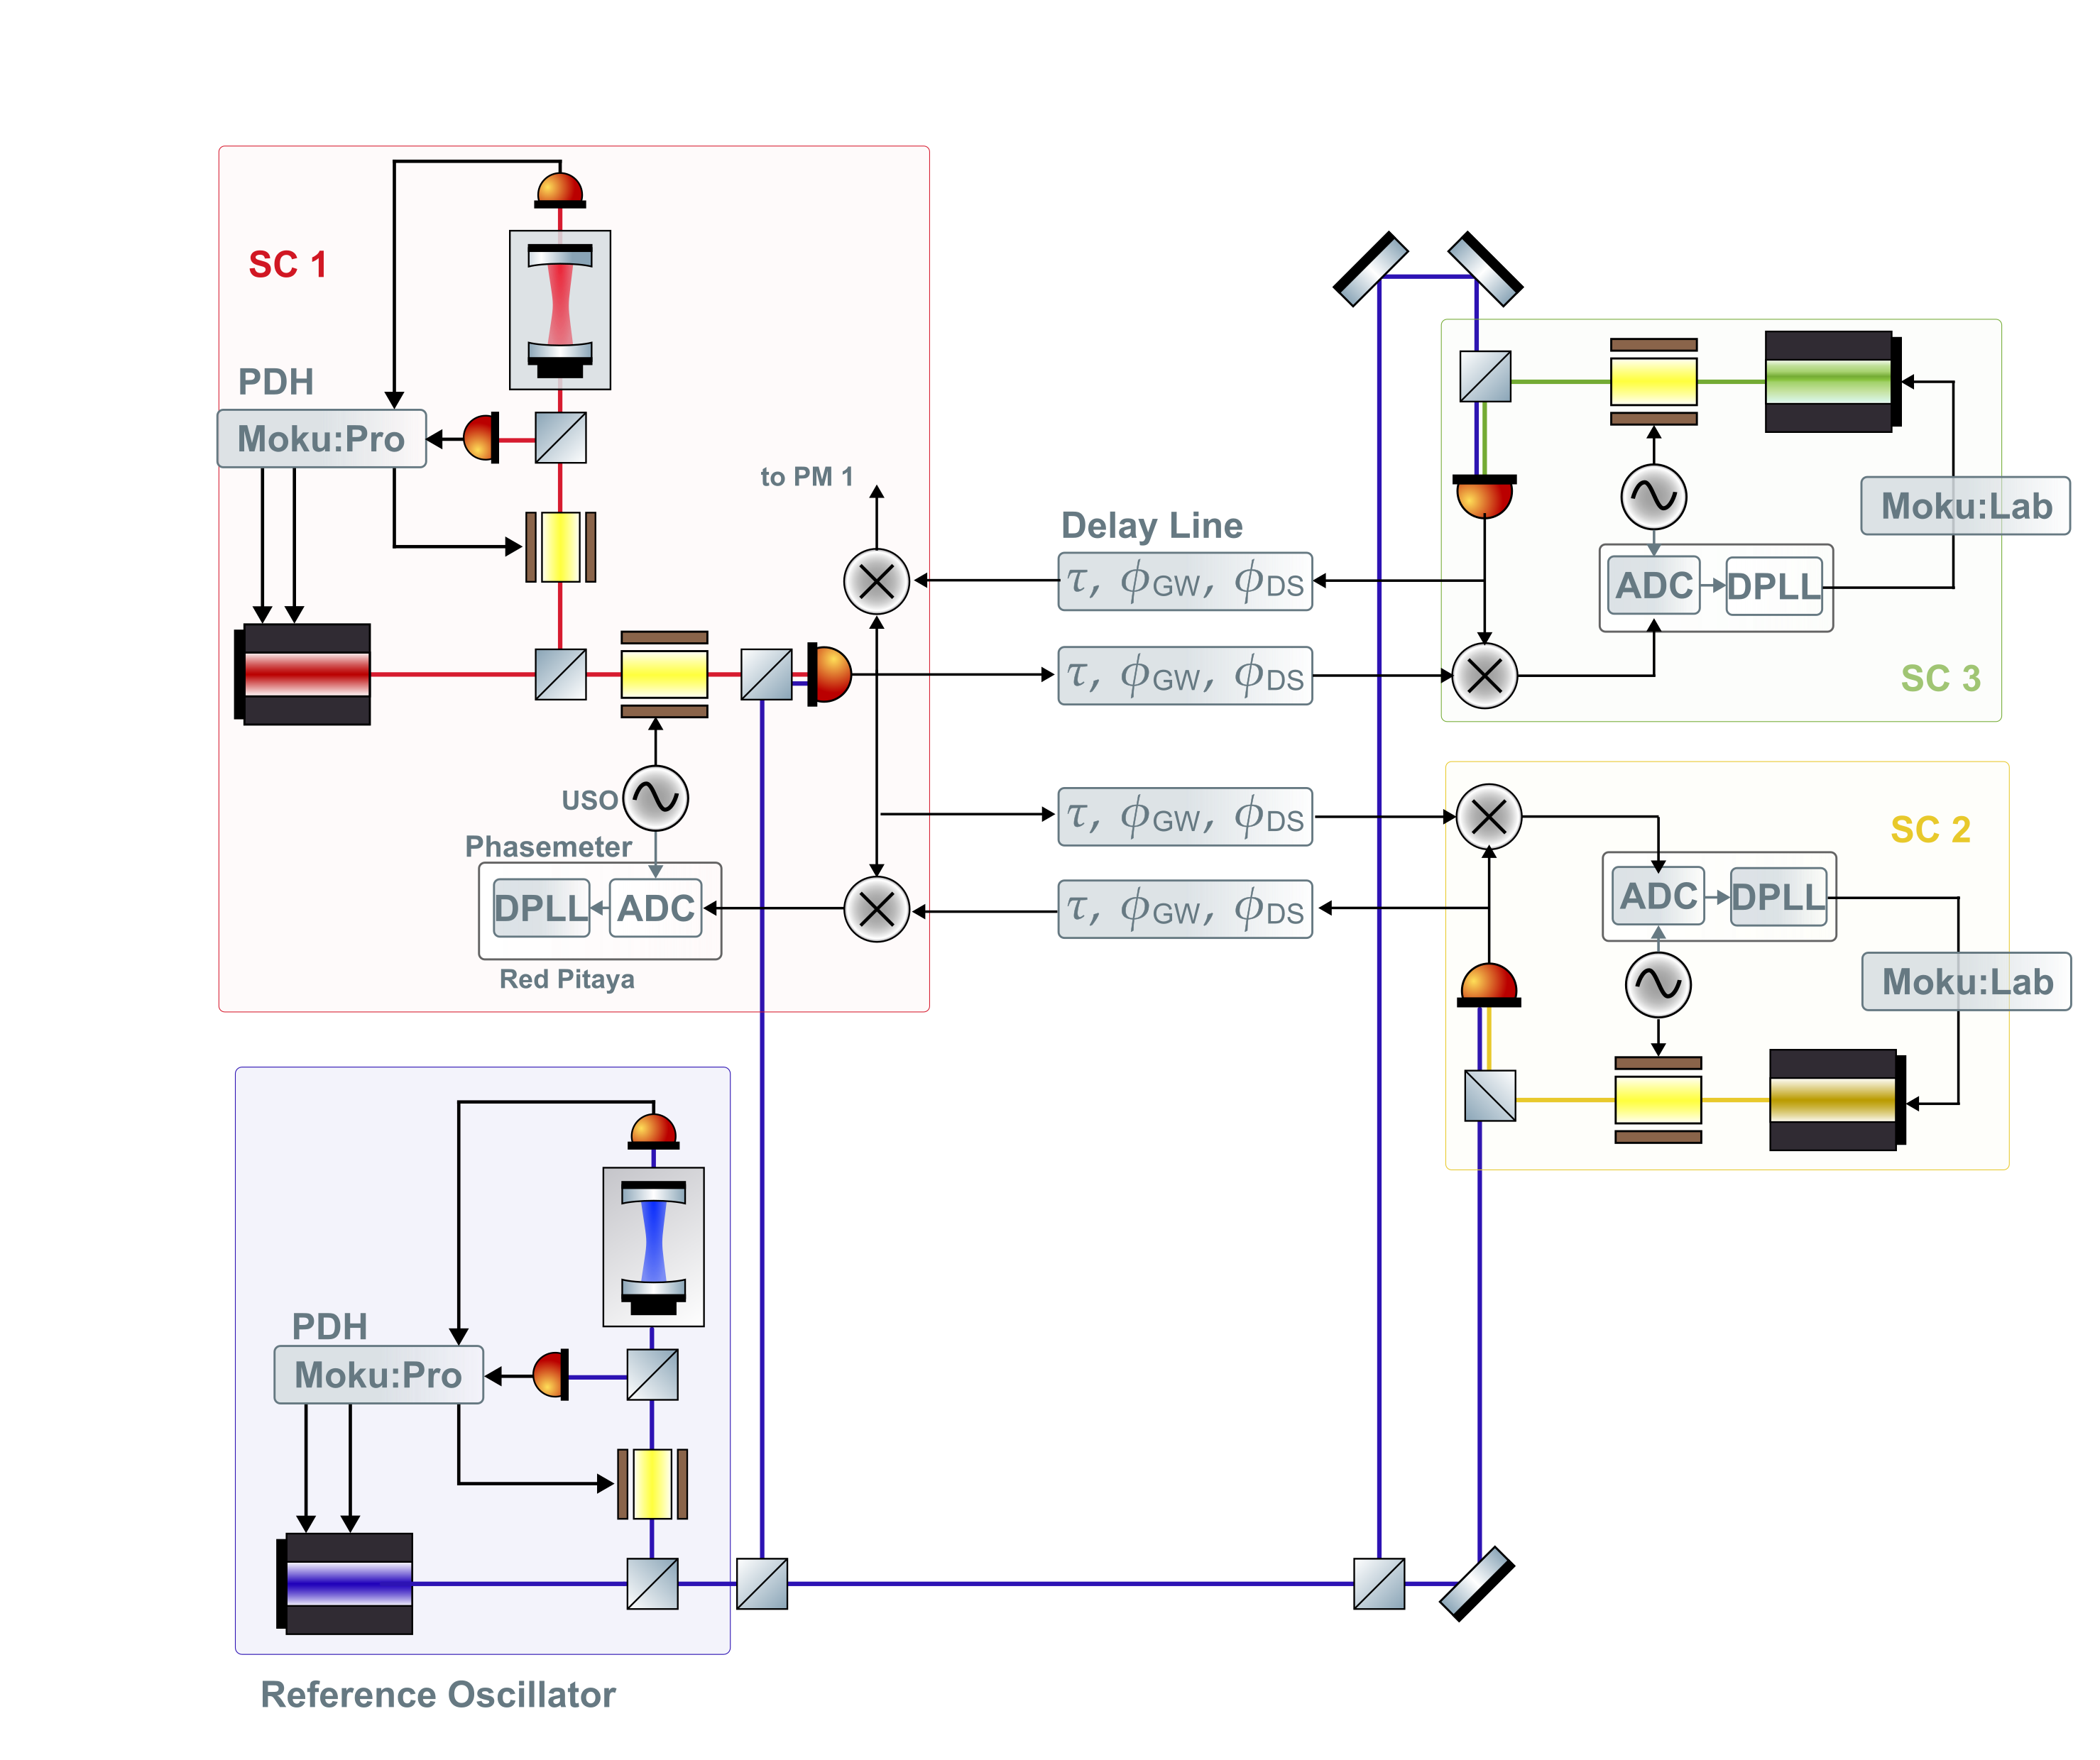
miniLISA setup

Slide 2

LISA Clock Signal Distribution
Sideband EOM
Left-side Frequency Distribution Module
50 MHz -> 2.39 GHz
2.39 GHz -> 37.5 MHz
Pilot Tone
Synthesizer
Frequency Divider (÷64)
PM ADC Channels
MCLK
50 MHz
50 MHz -> 2.391 GHz
2.391 GHz -> 37.5 MHz
Pilot Tone
Synthesizer
Frequency Divider (÷64)
PM ADC Channels
Right-side Frequency Distribution Module
Sideband EOM

Slide 3










LISA Timing Jitters
Sideband EOM
$${+x}_{EOM,12}$$
Left-side Frequency Distribution Module
$${+x}_{harness,12}$$
50 MHz -> 2.39 GHz
2.39 GHz -> 37.5 MHz
Pilot Tone
Synthesizer
Frequency Divider (÷64)
PM ADC Channels
$$x_{CLK}$$
$${+x}_{PLL,12}$$
$${+x}_{{PT}_{gen},12}$$
SC1, 12 side or
SC1 left side
MCLK
50 MHz
$${+x}_{harness,11}$$
SC1, 13 side or
SC1 right side
50 MHz -> 2.391 GHz
2.391 GHz -> 37.5 MHz
Pilot Tone
Synthesizer
Frequency Divider (÷64)
PM ADC Channels
$${+x}_{PLL,13}$$
$${+x}_{{PT}_{gen},13}$$
Right-side Frequency Distribution Module
$${+x}_{harness,13}$$
Sideband EOM
$${+x}_{EOM,13}$$

Slide 4
miniLISA version
Sideband EOM
(Left-side) Frequency Distribution Module
Function Generator
Pilot Tone
PM ADC Channels
SC1, 12 side or
SC1 left side
Rb CLOCK
10 MHz

Slide 5
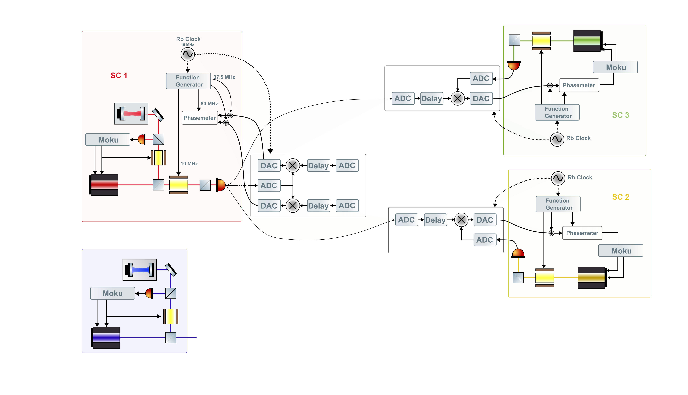

Slide 7
The Moku and function generator output channels can potentially be covered with one Delta, 2 Pros and 2 Labs. (?)
Purpose | # of channels | Moku (# of channels)
PDH laser controls (Laser 1, Ref) | 4 | Delta (4)
Sideband modulation (o(10MHz)) | 3 | Delta (1), Pro (2)
Phasemeter sampling clock (80 MHz) | 3 | Delta (1), Pro (2)
Pilot tone (37.5 MHz) | 3 (4) | Delta (1), Pro (2)
PLL laser locks | 4 | Labs (4)
But this is assuming we have the ZCU phasemeters.

Slide 8

miniLISA Timing Jitters
Sideband EOM
$${+x}_{EOM,12}$$
(Left-side) Frequency Distribution Module
Function Generator
Pilot Tone
PM ADC Channels
$${+x}_{FG,12}$$
SC1, 12 side or
SC1 left side
Rb CLOCK
10 MHz
The function generators can be the DELTA and the two PROs

Slide 9


About Requirements
After the pilot tone correction, LISA PM measurements are in the time base of the pilot tone. This is to say, the pilot tone is the “ultimate” PM time reference.
The pilot tone includes the timing jitters
However, the sidebands include terms
So there are some requitements set on these paths (excluding EOM noise)
Our setup doesn’t seem to include similar sources though, so currently its not that relevant.
$$x_{CLK}{+x}_{PLL,12}{+x}_{{PT}_{gen},12}$$
$$x_{CLK}{+x}_{PLL,12}{+x}_{harness,12}{+x}_{EOM,12}$$
Sideband generation
$$x_{PLL,12}{+x}_{harness,12}<10 ps/√Hz$$
Sideband vs PT (very important)
$$x_{harness,12}{−x}_{{PT}_{gen},12}<50 fs/√Hz$$

